Slide 1
AUDIT MANAGEMENT SYSTEM
Team members :
Logapriya - 2136186
Mahesh - 2135870
Sowmya sree - 2136122
Nishita Shetty - 2136107
Pod 1- Cohort : INTCDE22IJ040

Slide 2
Table of contents
Problem statement
Objective
Approach and Plan of the project
Requirements
System Architecture
Microservices and Modules
Flow chart
Screenshots
Pod 1- Cohort : INTCDE22IJ040

Slide 3
Problem Statement
A leading Supply chain Management Organization wants to automate the Audit processing Thus ,
The Organization want us to develop an audit management system.And requested to deploy them in AWS.
They wanted us to built UI on Angular as well.
Pod 1- Cohort : INTCDE22IJ040

Slide 4
Objective
The main objective of this project is
To make the Audit management scalable
To ensure clarity
Ease of tracking for the organization
Pod 1- Cohort : INTCDE22IJ040

Slide 5
Approach toward the project
Firstly we read the SRS document and divided the work among ourselves.
Then we started developing microservices and the User Interface
after creating a github repository and shared our local work in that repository.
After microservices are developed in local system, we started integrating and testing microservices and Ul together.
Finally we deployed microservices on Amazon Web Service (AWS)
Pod 1- Cohort : INTCDE22IJ040

Slide 6
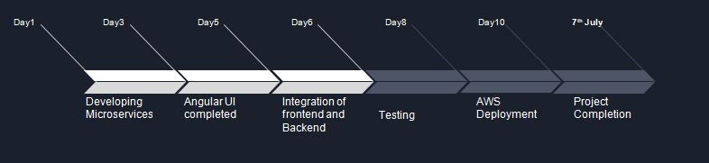
Plan of the project
Pod 1- Cohort : INTCDE22IJ040

Slide 7
Requirements
Hardware requirements
Pc / Laptop - 8 GB RAM preferably
Software requirements
Eclipse - Latest version
Node js
Lambok
Visual studio code
AWS access
Pod 1- Cohort : INTCDE22IJ040

Slide 8
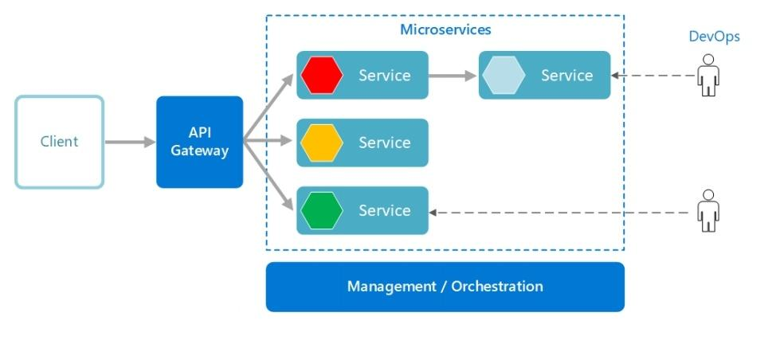
System Architecture
Pod 1- Cohort : INTCDE22IJ040

Slide 9
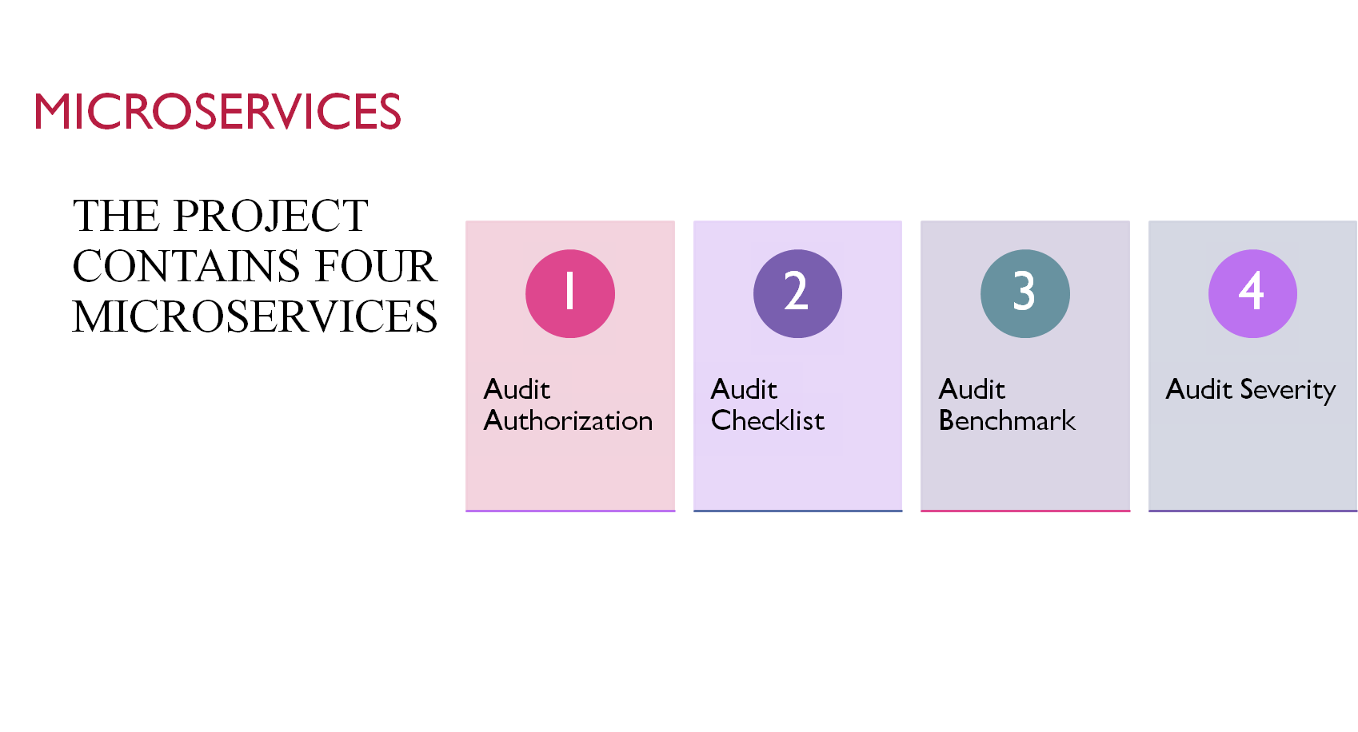
Pod 1- Cohort : INTCDE22IJ040

Slide 10
Modules
Frontend Module :
Angular Framework is used
Audit management Portal must allow a member to Login.
After logged in, Choose the audit type to view the list of audit checklist questions
Let the project manager provide answers to the questions
Invoke the Audit Severity Microservice to determine the project execution status
Display the result on the Web UI
The audit responses and execution status and remedial action duration will be saved to the database
Pod 1- Cohort : INTCDE22IJ040

Slide 11
Modules
Backend Modules :
Audit Authorization - provides the endpoints for authentication and validation.
Audit Checklist - Middleware microservice that is used to get the list of questions from database
Audit Benchmark - Middleware microservice that stores the number of acceptable “No” in the database
Audit Severity - Middleware microservice that checks the project execution status and returns the status and remedial action to be taken
Pod 1- Cohort : INTCDE22IJ040

Slide 12
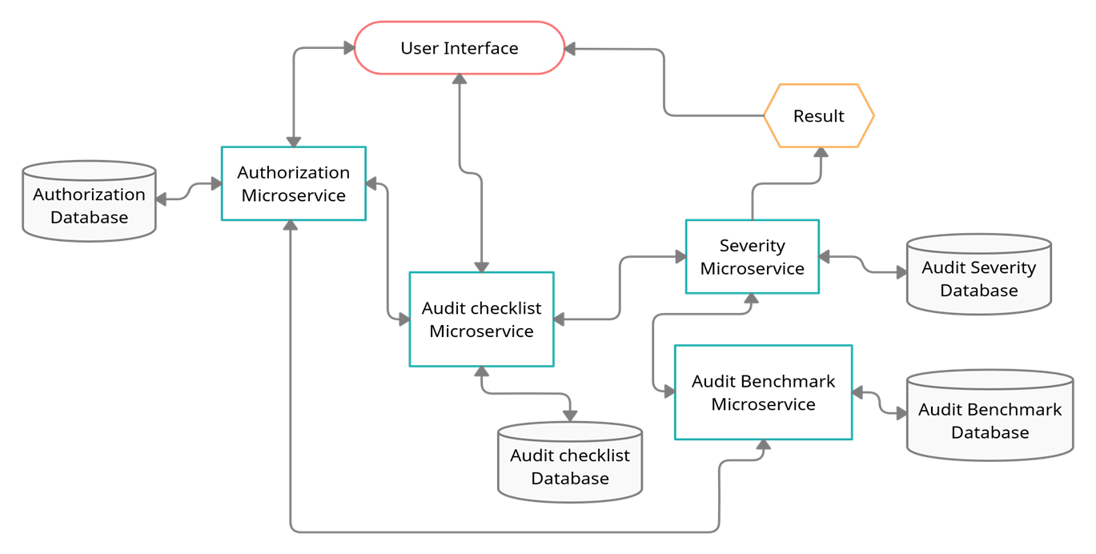
Flow chart
Pod 1- Cohort : INTCDE22IJ040

Slide 13
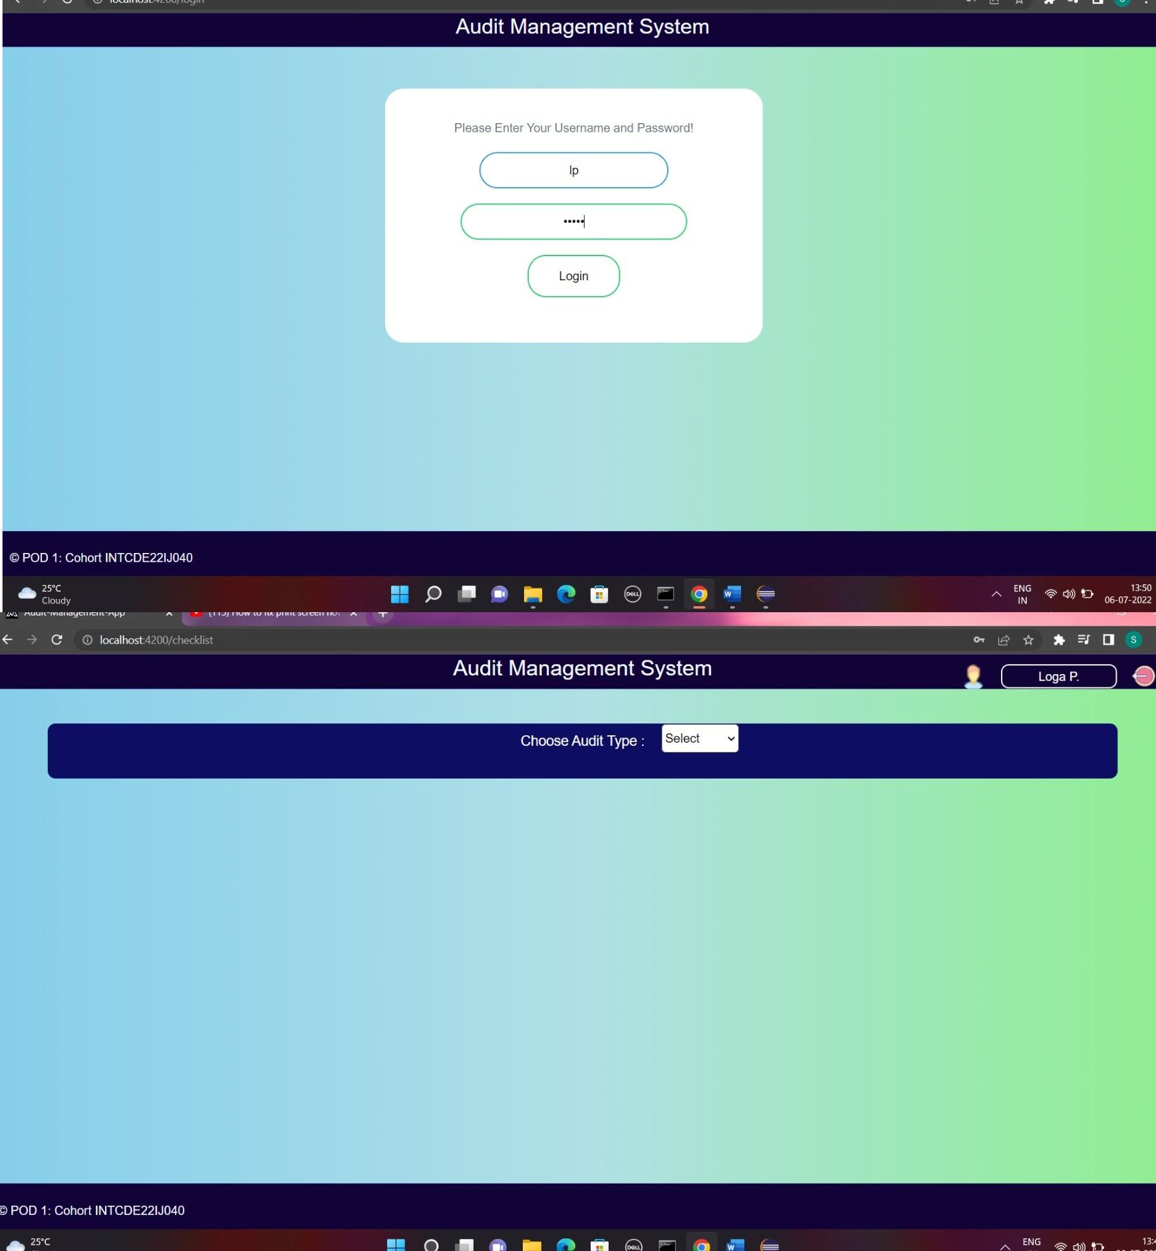
Screenshots
Pod 1- Cohort : INTCDE22IJ040

Slide 14
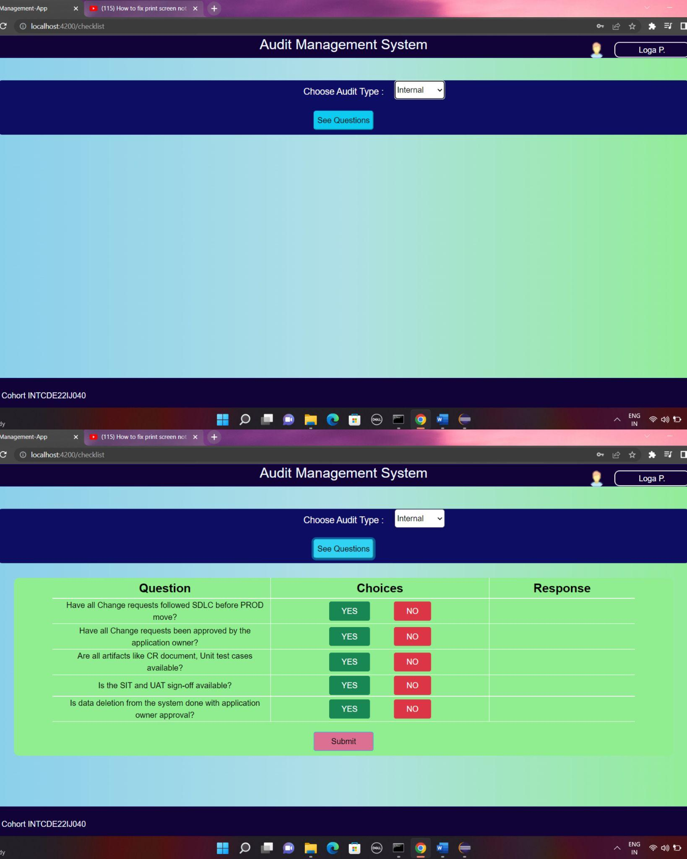
Screenshots
Pod 1- Cohort : INTCDE22IJ040

Slide 15
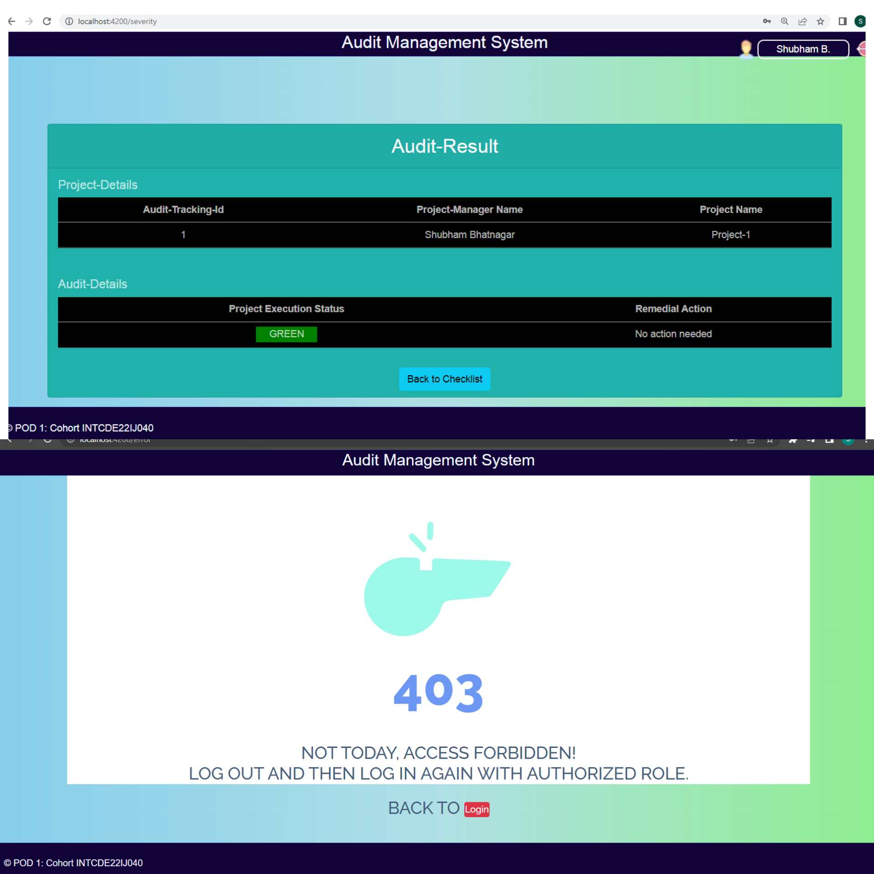
Screenshots
Pod 1- Cohort : INTCDE22IJ040

Slide 16
Screenshots
Pod 1- Cohort : INTCDE22IJ040

Slide 17
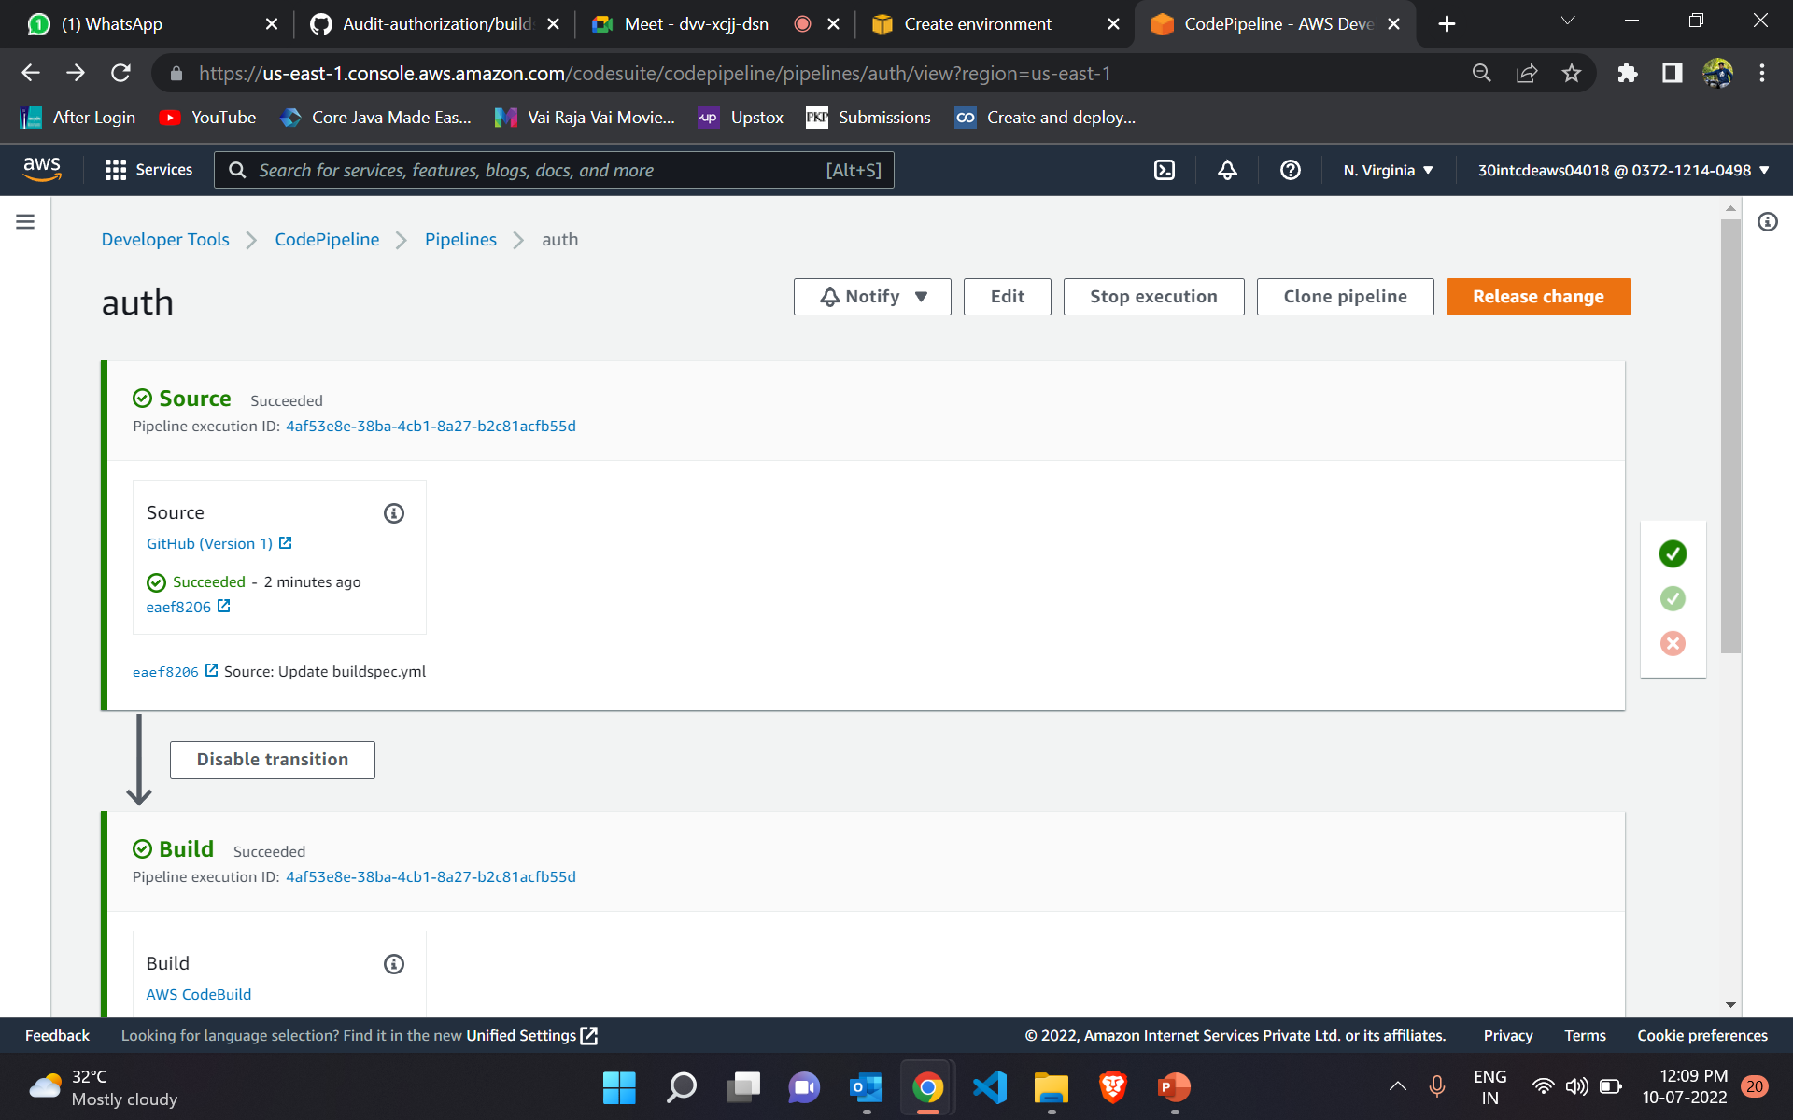
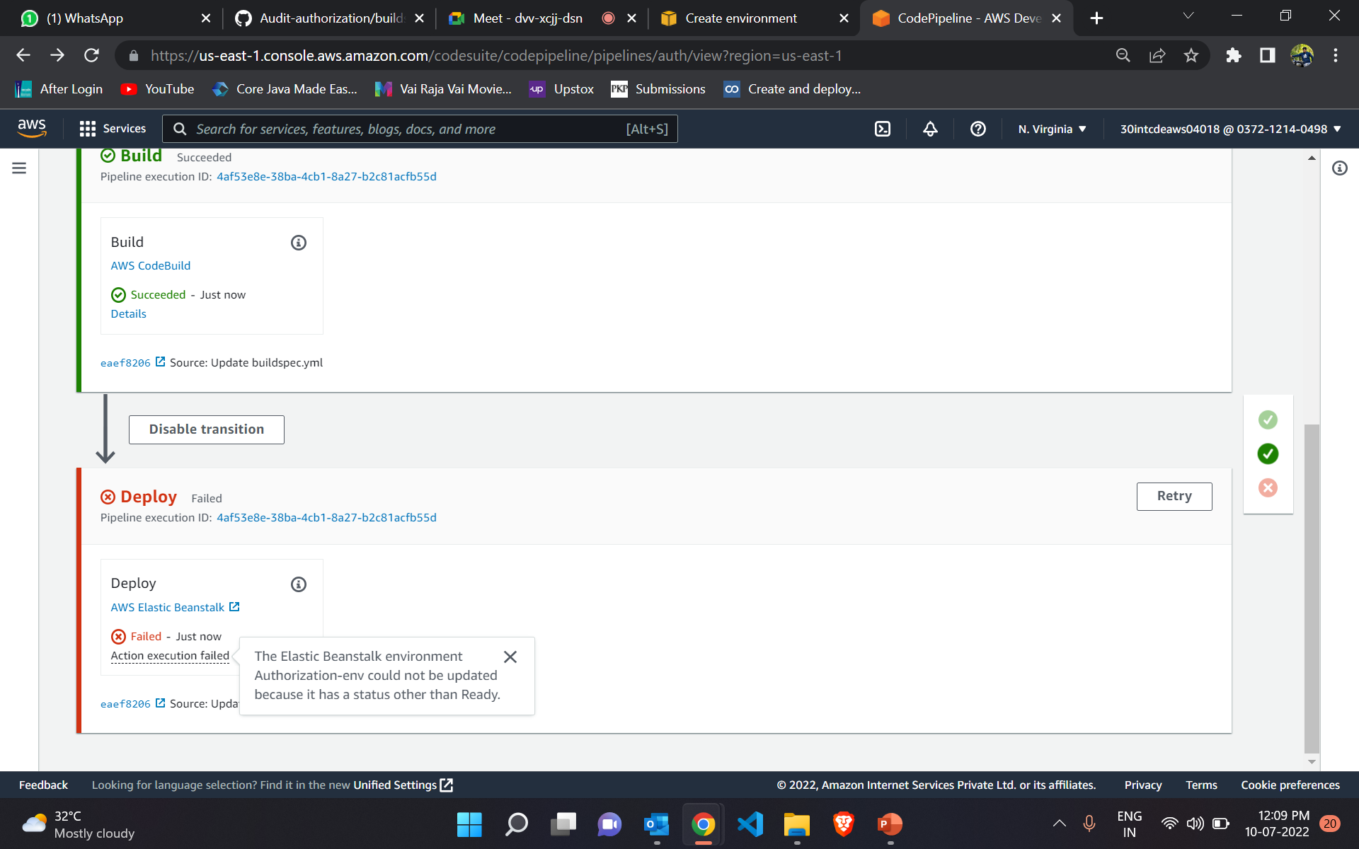
AWS Deployment
Pod 1- Cohort : INTCDE22IJ040

Slide 18
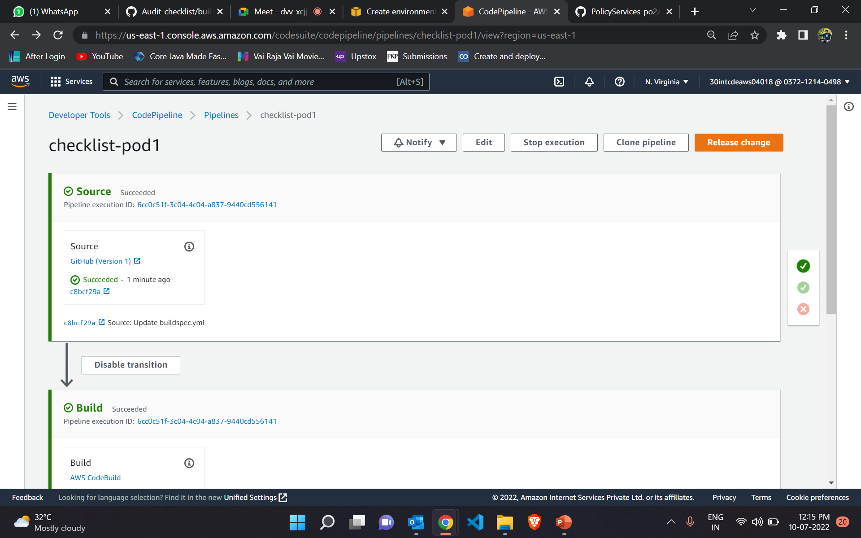
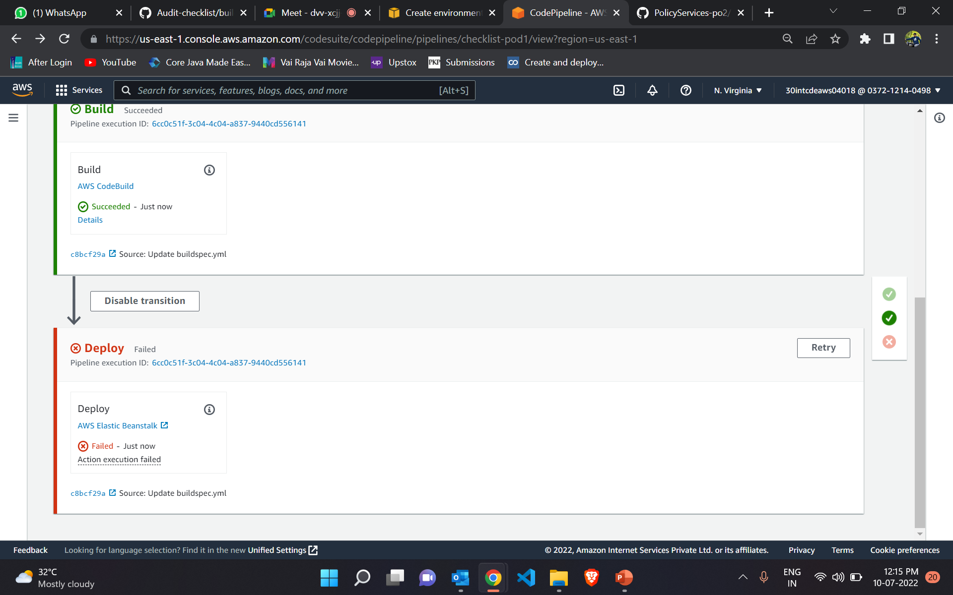
AWS Deployment
Pod 1- Cohort : INTCDE22IJ040

Slide 19
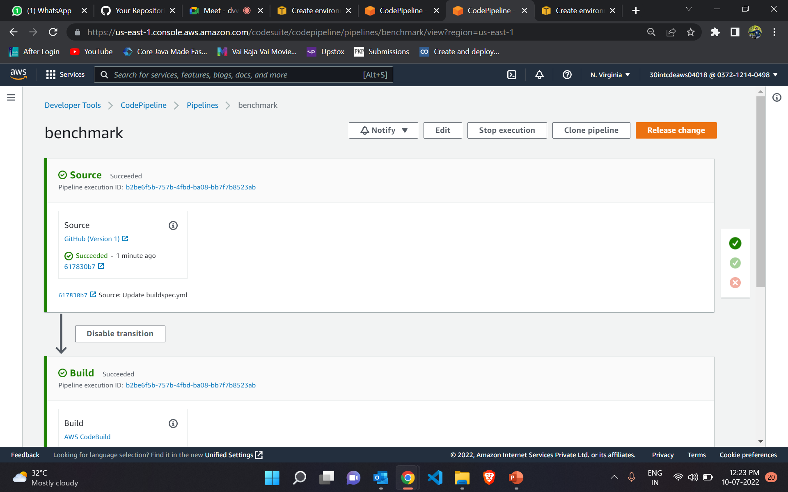
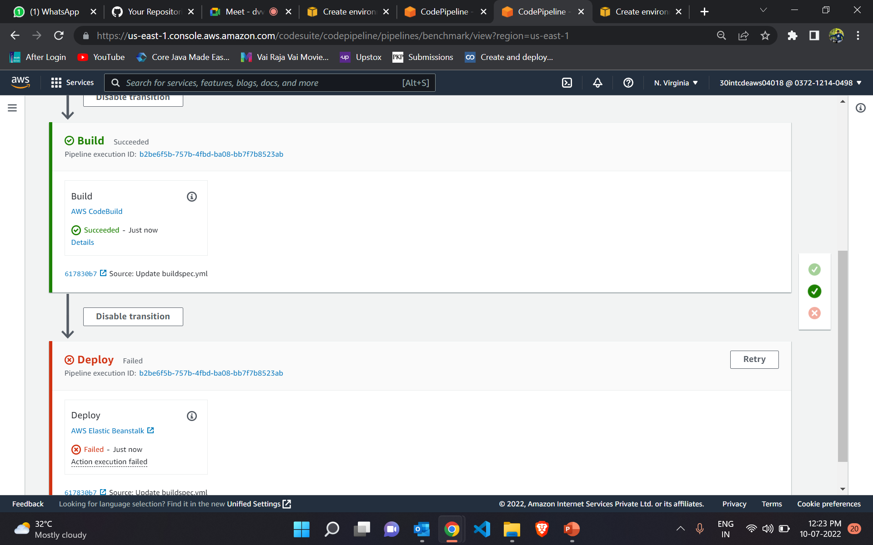
AWS Deployment
Pod 1- Cohort : INTCDE22IJ040

Slide 20
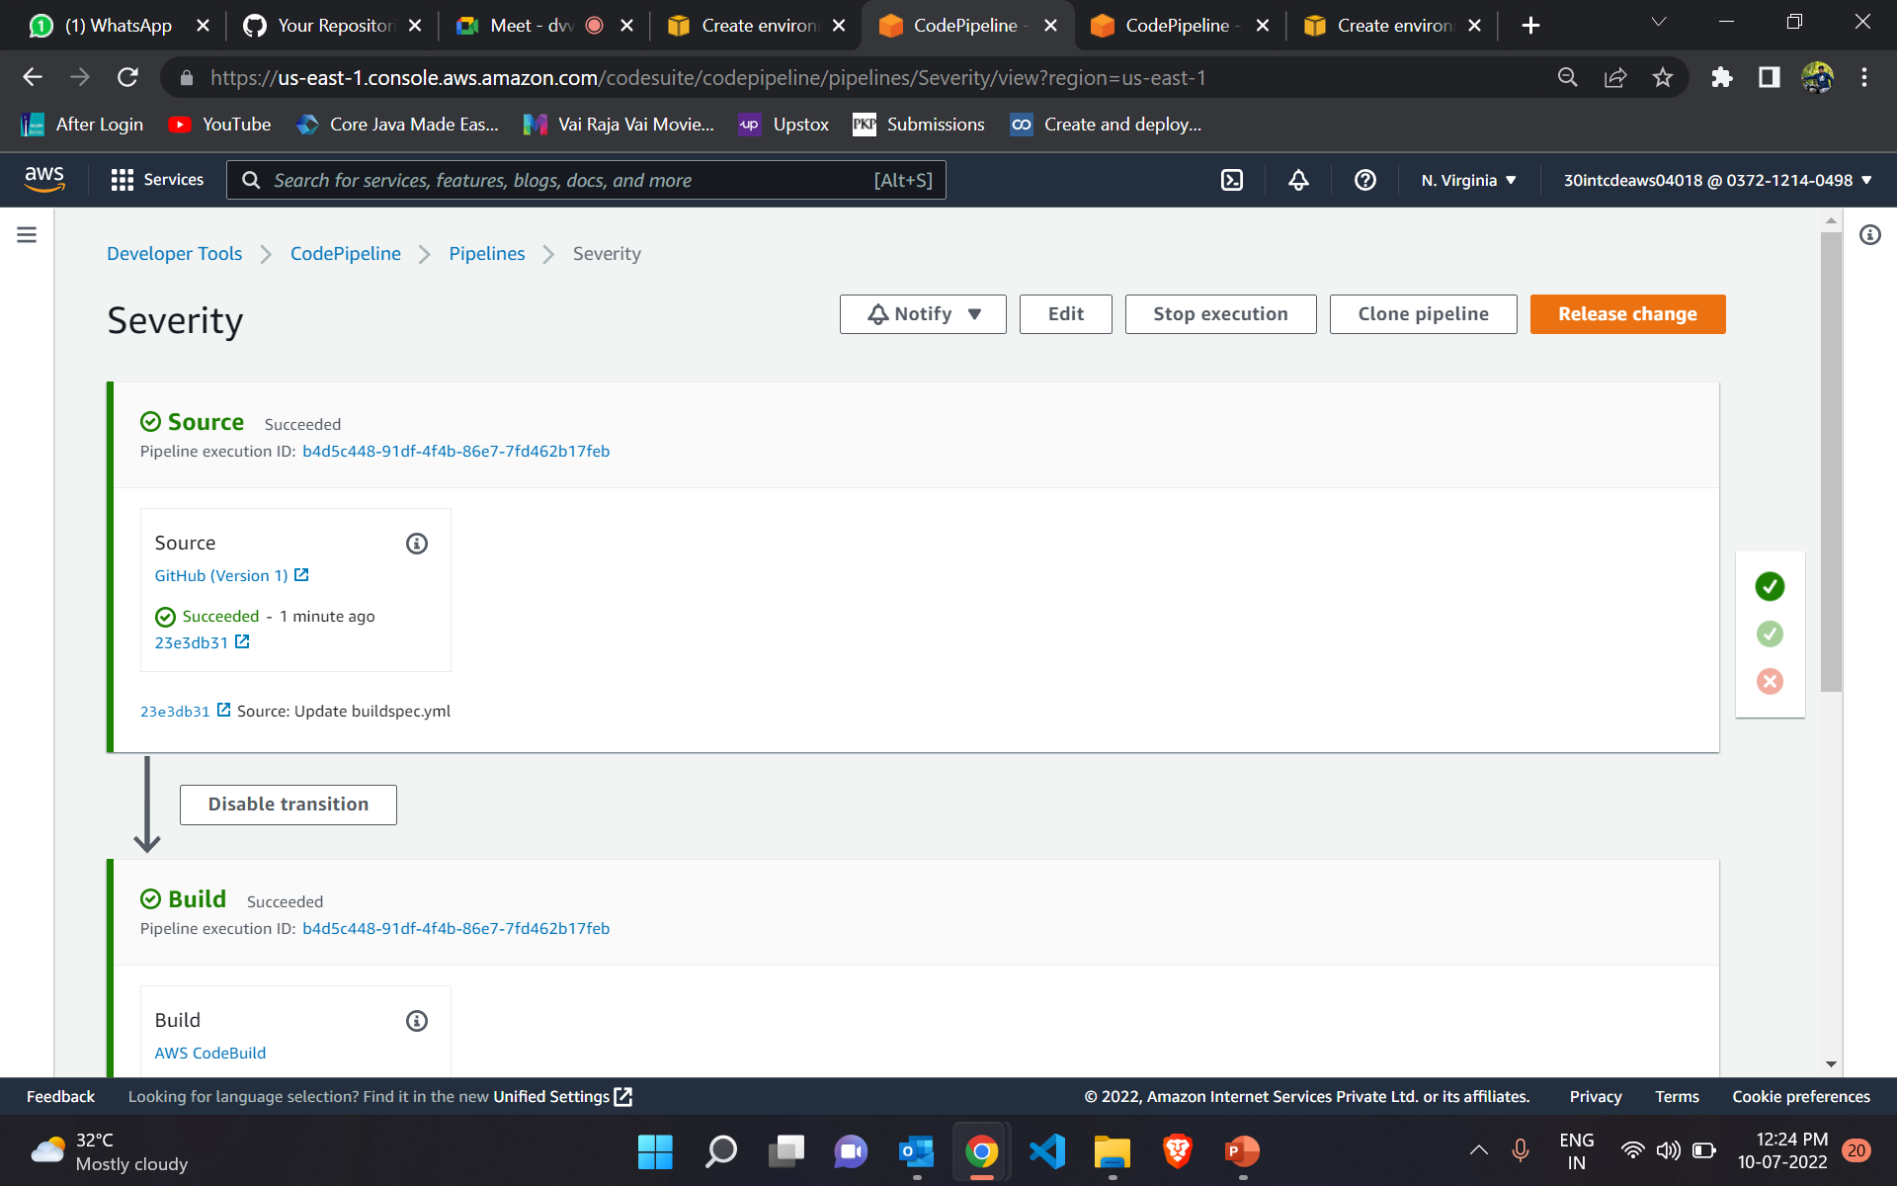
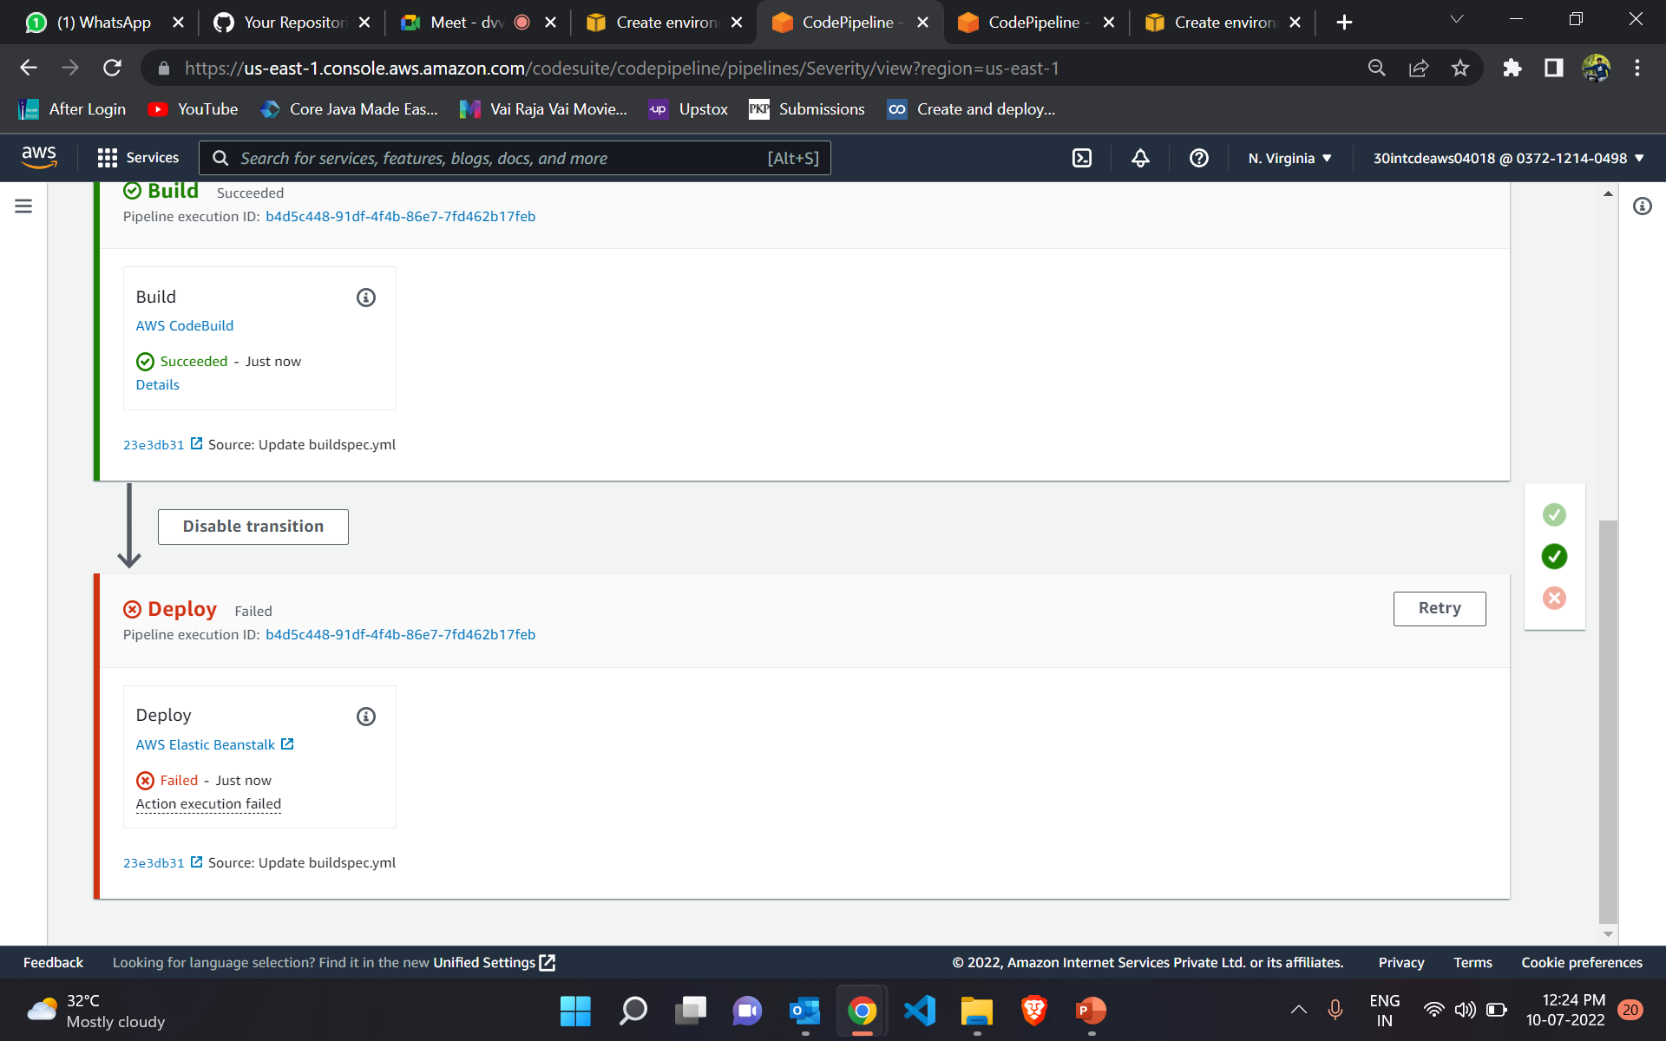
AWS Deployment
Pod 1- Cohort : INTCDE22IJ040

Slide 21
Conclusion
All user requirements are meet
All the modules are functional
Thus the Project is successfully completed and deployed on AWS
Pod 1- Cohort : INTCDE22IJ040

Slide 22
Thank you
Pod 1- Cohort : INTCDE22IJ040

